Slide 1
Fittings
Francis Adoah

Slide 2
Project 1: HATNA derivatives with electron-donating/withdrawing groups
F₄-HATNA-OC₁₀SAc
(MeO)₄-HATNA-OC₁₀SAc
(NO₂)₄-HATNA-OC₁₀SAc
(NH₂)₄-HATNA-OC₁₀SAc

Slide 3
Table 1. Summary of surface characterization of HATNA molecules on Au
Molecule |  |  | Energy levels (eV) |  |  |  |  | Surface coverage (10⁻¹⁰ mol/cm²) ^{c}
 |  | E_{HOMO} | E_{LUMO} | E_{LUMO+1} | E_{LUMO+2} | E_{F}ª | E_{gap}^{b}
HATNA | Exp. | -6.33^{d} | -3.52^{d} | -3.30^{d} | -2.97^{d} |  | 2.81 | 2.73±0.35
 |  | -6.90e | -4.09e
 |  | -6.28^{f} | -3.47^{f} |  |  | 4.18
 | Theor.^{g} | -6.17 | -2.79 | -2.37 | -2.31
F₄-HATNA | Exp. | -6.41 | -3.62 | -3.26 | -2.96 |  | 2.79 | 1.32±0.14
 |  | -6.89 | -4.10
 |  | -6.12 | -3.33 |  |  | 4.02
 | Theor. | -6.37 | -3.09 | -2.67 | -2.62
(MeO)₄-HATNA | Exp. | -6.18 | -3.44 | -3.16 | -2.74 |  | 2.74 | 2.96±0.19
 |  | -6.83 | -4.09
 |  | -5.80 | -3.06 |  |  | 3.88
 | Theor. | -5.99 | -2.58 | -2.2 | -2.11
(NO₂)₄-HATNA | Exp. | -6.75 | -4.15 | -3.89 | -3.58 |  | 2.60 | 2.33±0.13
 |  | -6.71 | -4.11
 |  | -6.83 | -4.23 |  |  | 3.76
 | Theor. | -6.65 | -4.11 | -3.71 | -3.62
(NH₂)₄-HATNA | Exp. | -5.65 | -3.37 | -2.79 | -2.64 |  | 2.28 | 2.00±0.10
 |  | -6.39 | -4.11
 |  | -5.41 | -3.13 |  |  | 4.01
 | Theor. | -5.45 | -2.23 | -1.81 | -1.74
H₆-HATNA | Theor. | -4.35 | -0.38 | -0.34 | -0.27
F₄-(H₆-HATNA) | Theor. | -4.68 | -0.77 | -0.68 | -0.66
(MeO)₄-(H₆-HATNA) | Theor. | -4.29 | -0.33 | -0.27 | -0.23
(NO₂)₄-(H₆-HATNA) | Theor. | -5.50 | -3.07 | -3.03 | -2.34
(NH₂)₄-(H₆-HATNA) | Theor. | -4.00 | -0.05 | 0.05 | 0.10
ª Measured with UPS.
^{b} Measured with UV.
^{c} Measured with SAM CV.
^{d} Measured with solution CV and UV.
^{e} Measured with SAM CV and UV
^{f} Measured with UPS and UV.
^{g} Calculated with DFT in gas phase

Slide 4
Project 2: HATNA, TAP and DAP derivatives
HATNA-OC₁₀SAc
TAP-OC₁₀SAc
DAP-OC₁₀SAc

Slide 5
Table 2. Summary of surface characterization of DAP, TAP and HATNA SAMs on Au
Molecule |  | Energy levels (eV) |  |  |  |  |  | Surface coverage (10⁻¹⁰ mol/cm²)^{c}
 |  | E_{HOMO} | E_{LUMO} | E_{LUMO+1} | E_{LUMO+2} | E_{F}ª | E_{gap}^{b}
HATNA | Exp.^{d} | -6.28±0.1 | -3.54 |  |  | -4.18 | 2.74 | 2.73±0.35
 | Theor.^{e} | -6.27 | -2.79 | -2.39 | -2.32
TAP | Exp. | -6.17±0.1 | -3.43 |  |  | -4.06 | 2.74 | 2.10±0.34
 | Theor. | -6.19 | -2.56 | -2.55
DAP | Exp. | -6.06±0.1 | -3.24 |  |  | -4.16 | 2.82 | 2.86±0.14
 | Theor. | -5.95 | -2.56
HATNA-H₆ | Theor. | -4.37 | -0.57 | -0.40 | -0.36
HATNA-H₄ | Theor. | -4.24 | -2.38 | -0.67 | -0.59
HATNA-H₂ | Theor. | -4.53 | -2.48 | -2.41 | -0.78
TAP-H₄ | Theor. | -4.36 | -0.57 | -0.31
TAP-H₂ | Theor. | -4.48 | -2.48 | -0.65
DAP-H₂ | Theor. | -4.31 | -0.57
ª Measured with UPS.
^{b} Measured with UV.
^{c} Measured with CV.
^{d} Measured with UPS and UV.
^{e} Calculated with DFT in gas phase

Slide 6
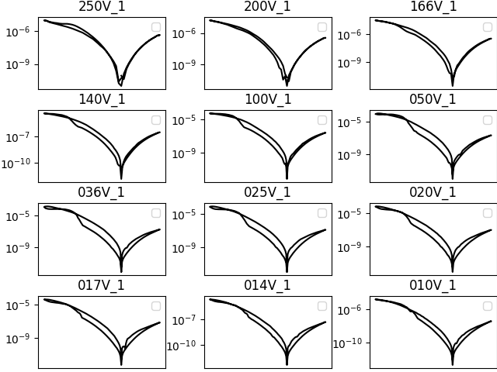
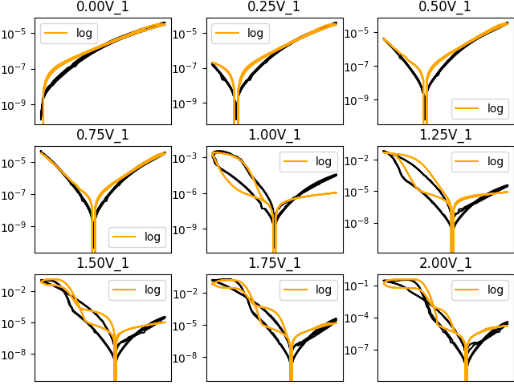
Sanity check on (NH2)4-HATNA
SR_data on log-scale
Neg-bias data

Slide 7
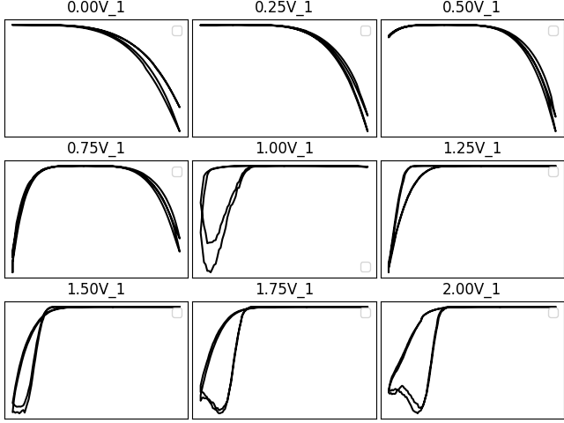
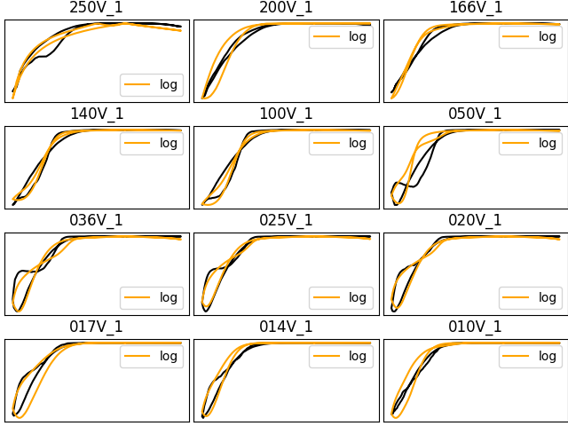
Sanity check on (NH2)4
Neg_bias without log-scale
SR_data

Slide 8
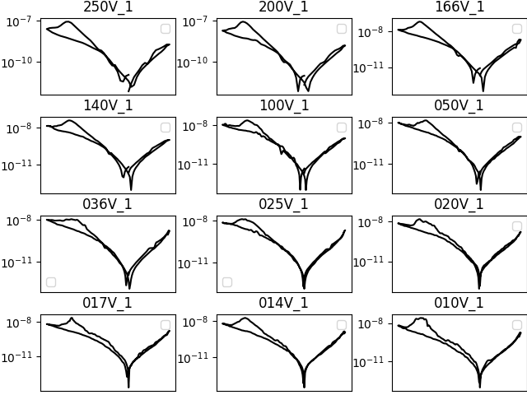
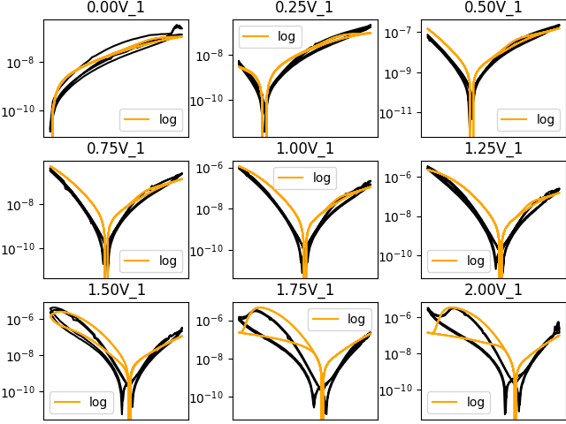
Sanity check on DAP
SR_data on log-scale
Neg_bias data

Slide 9
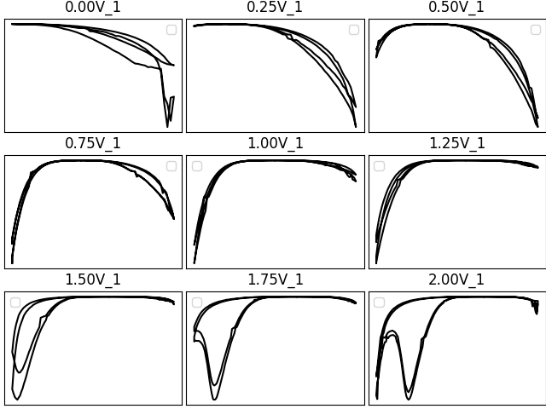
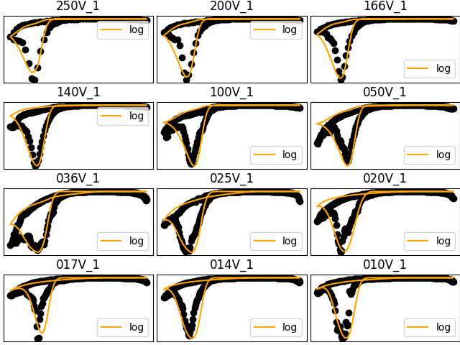
Sanity check on DAP
Neg_bias without log-scale
SR_data

Slide 10
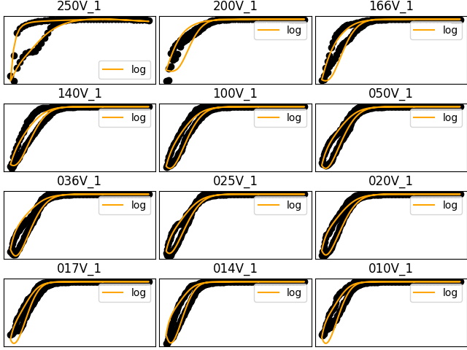
Scan rate fittings for (NH2)4 & (NO2)4(Project_1)
NO2
NH2

Slide 11
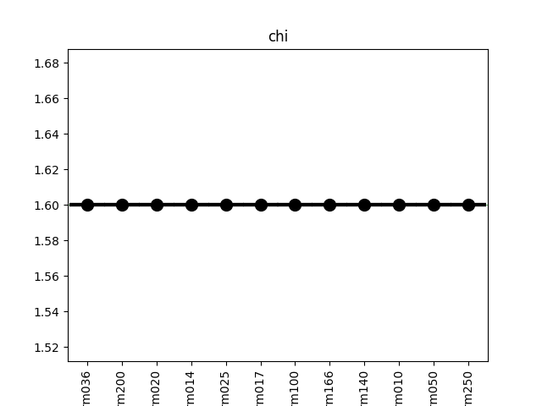
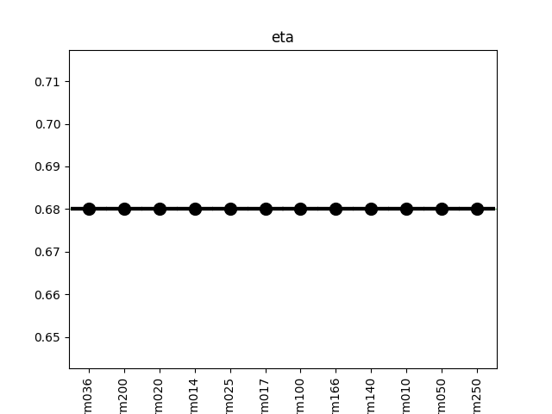
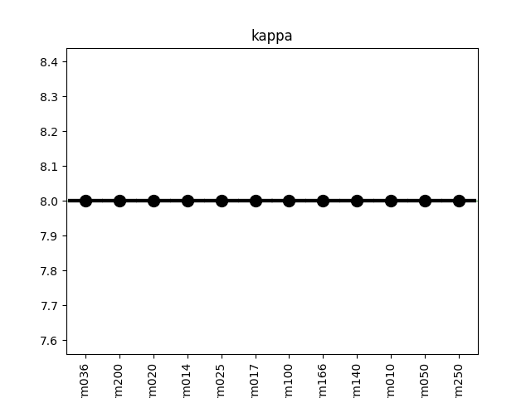
(NO2)4 parameters

Slide 12
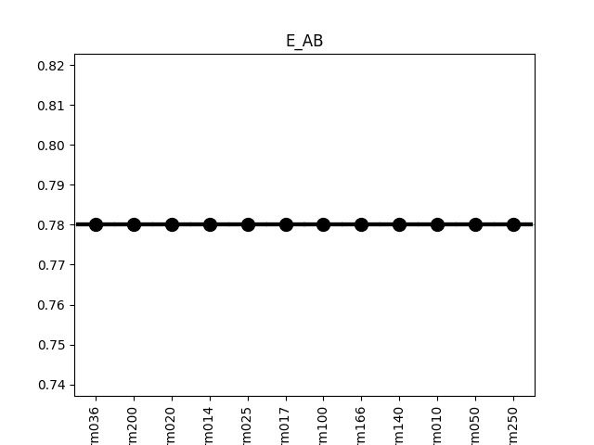
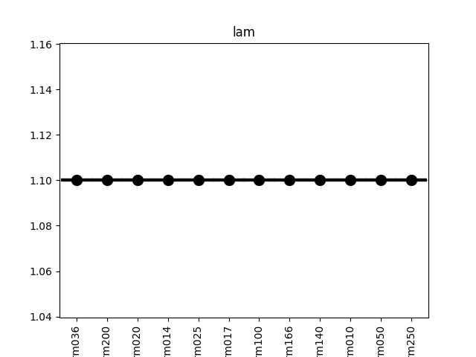
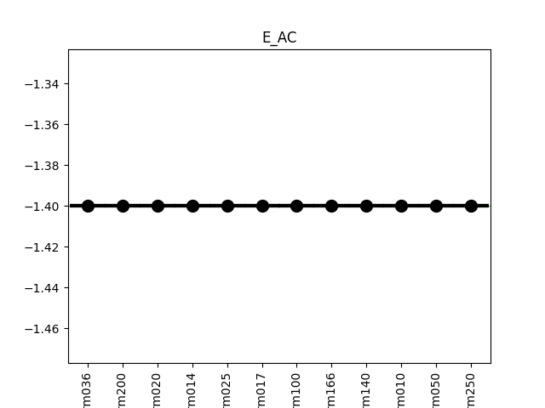

Slide 13
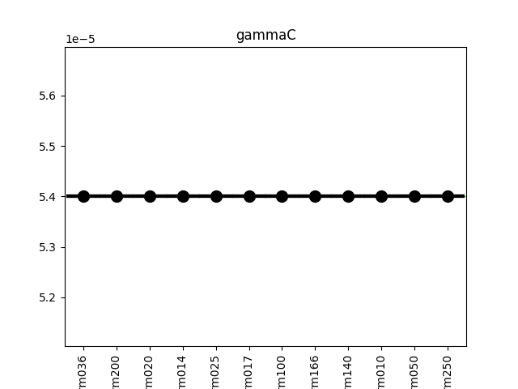
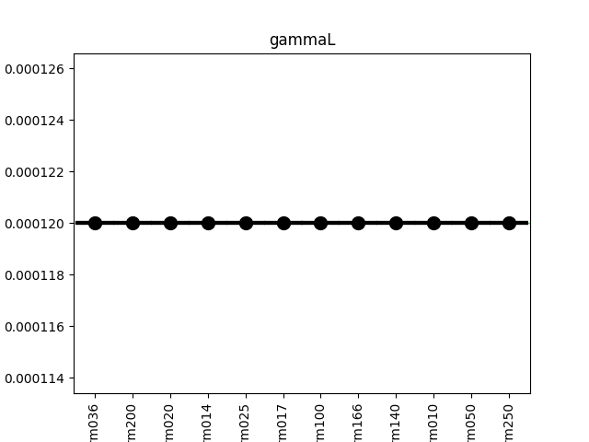
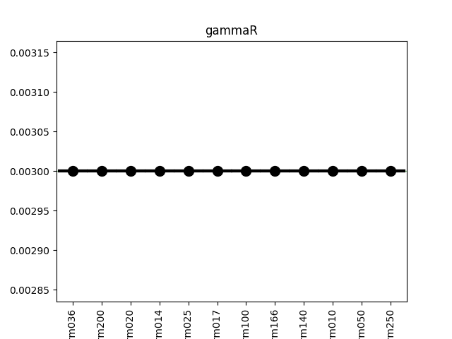

Slide 14
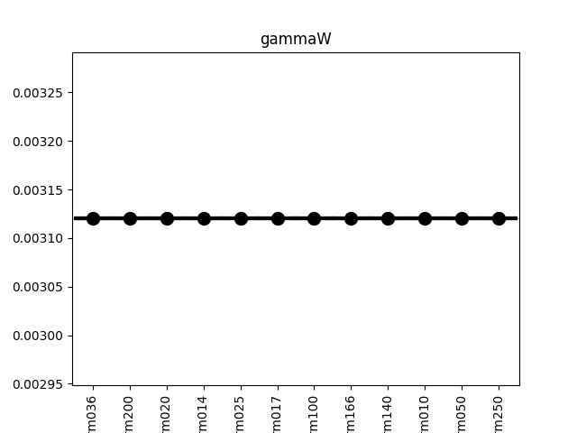
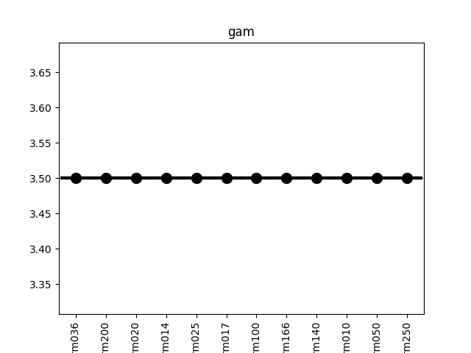

Slide 15
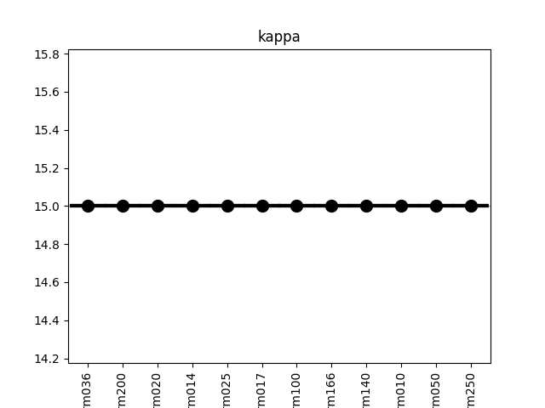
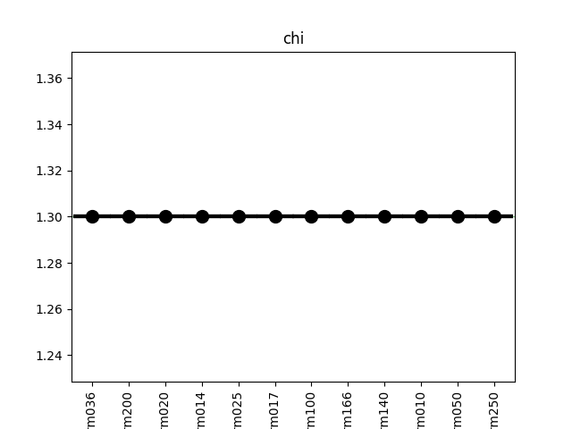
(NH2)4 Parameters

Slide 16
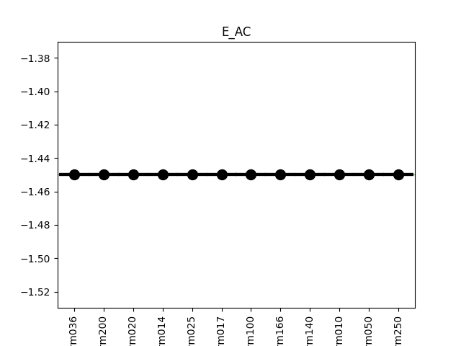
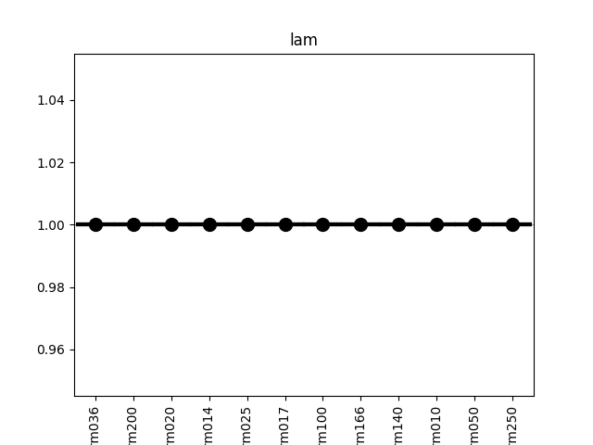

Slide 17
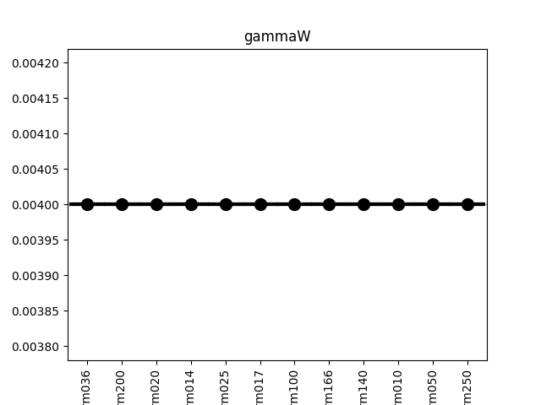
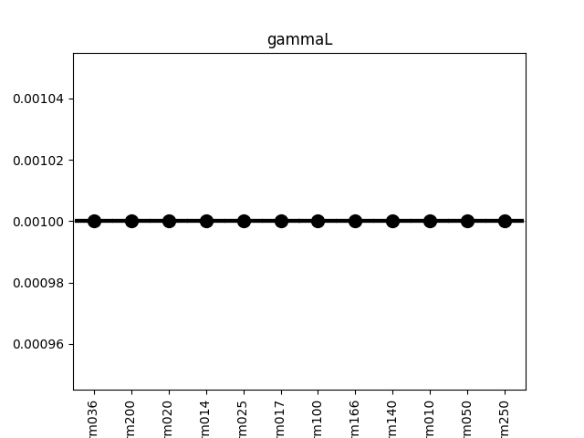

Slide 18
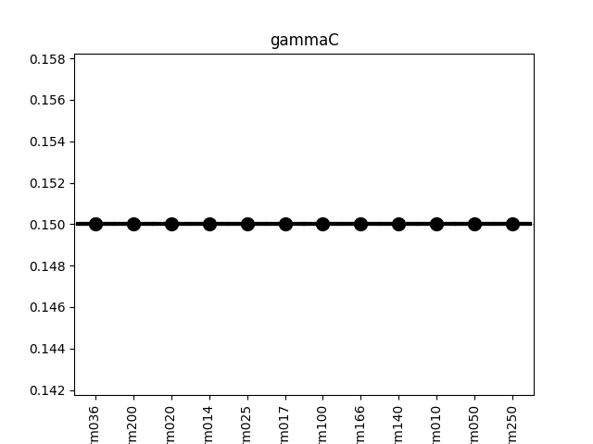
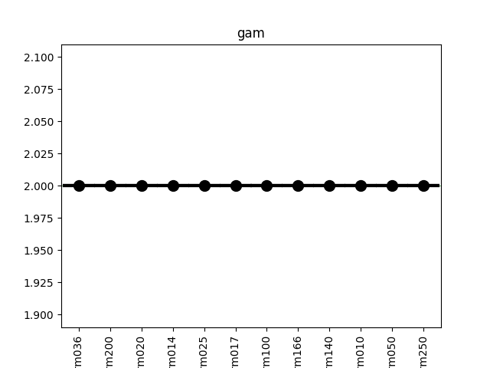

Slide 19
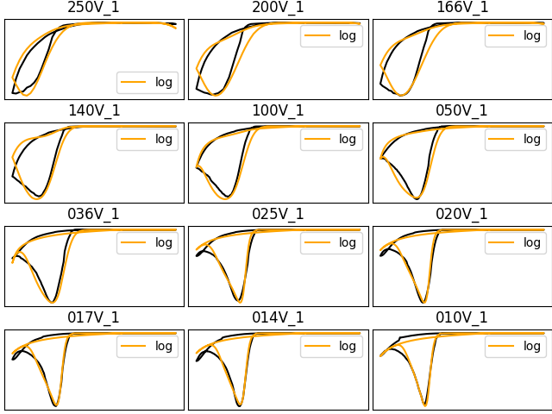
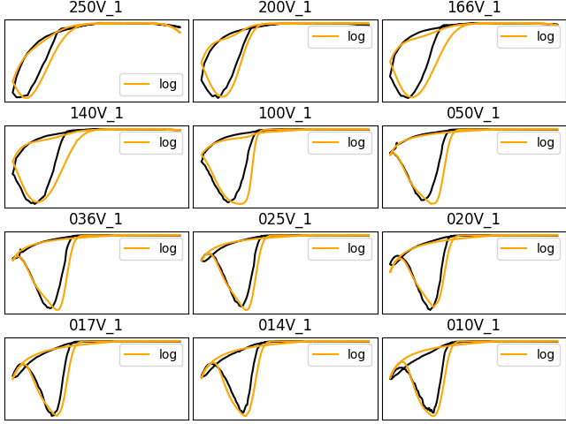
Scan rate fittings for F4 & MeO(Project_1)
F4-HATNA
MeO

Slide 20
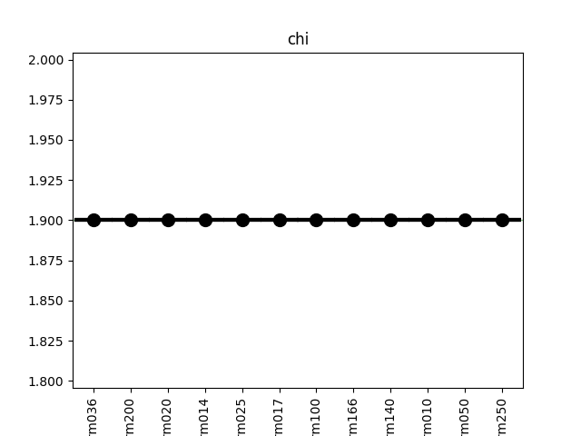
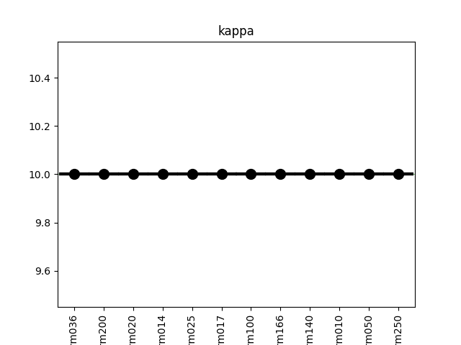
F4-HATNA parameters

Slide 21
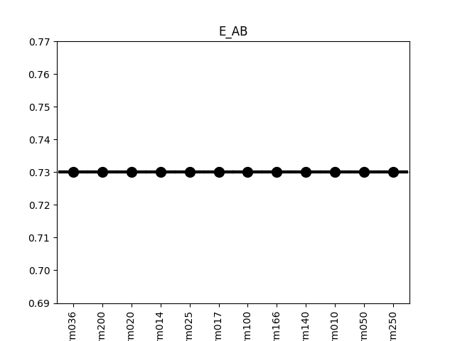
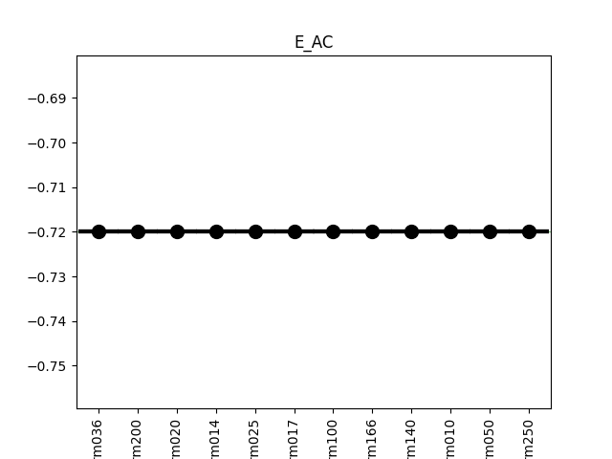
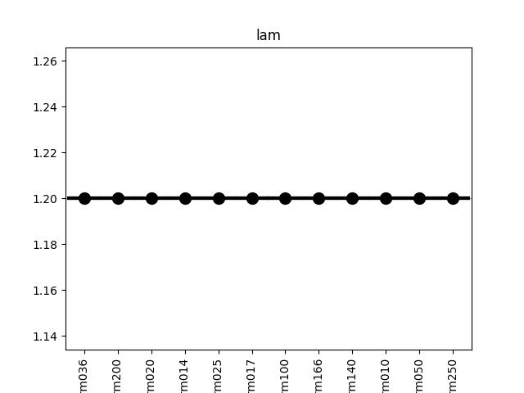

Slide 22
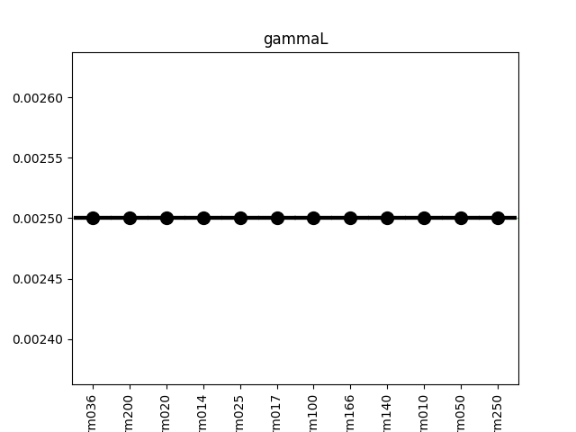
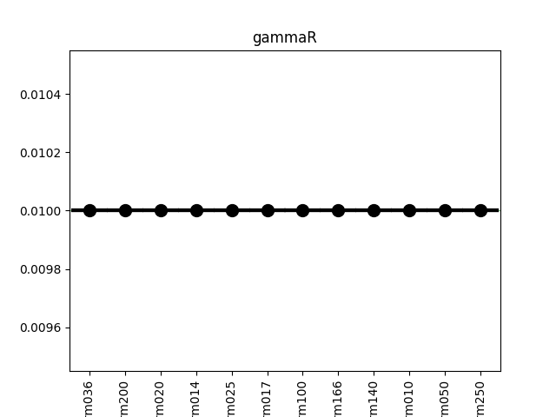
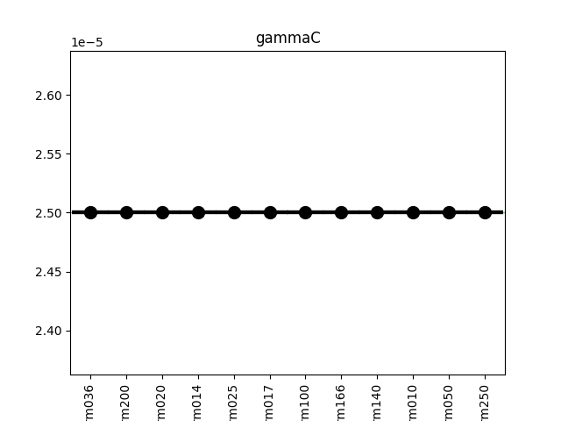

Slide 23
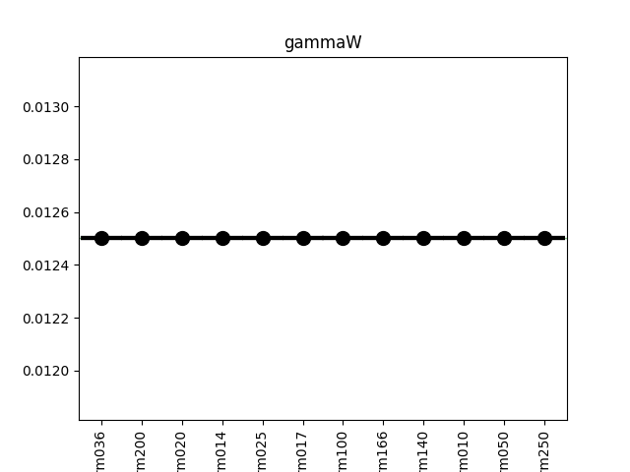
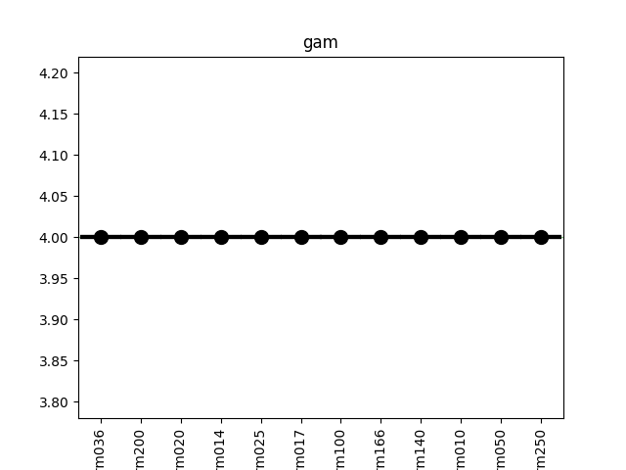

Slide 24

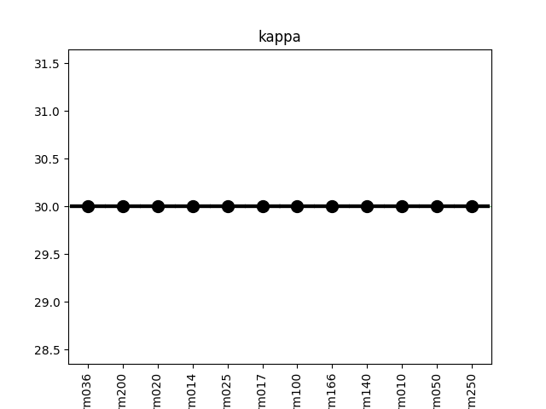
MeO-HATNA parameters

Slide 25



Slide 26
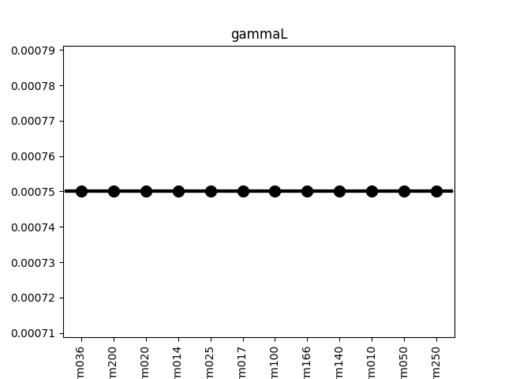

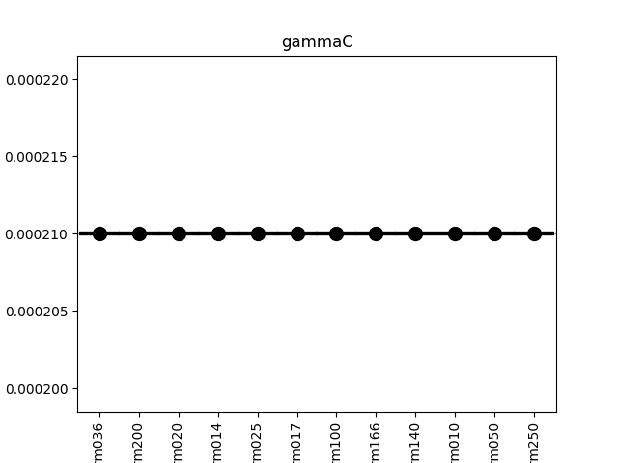

Slide 27
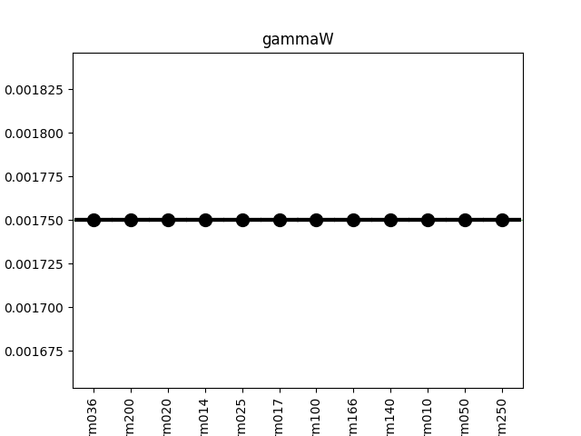


Slide 28
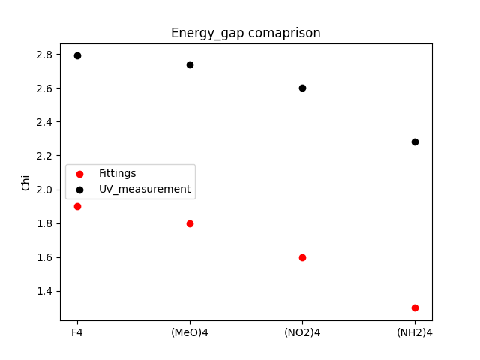
Energy gap comparison

Slide 29
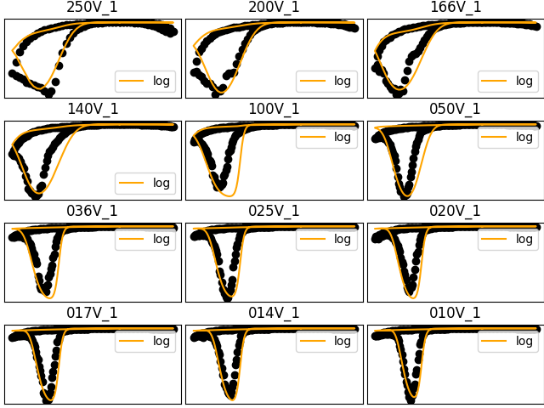
Scan rate fittings for DAP & TAP(Project_2)
TAP
DAP

Slide 30
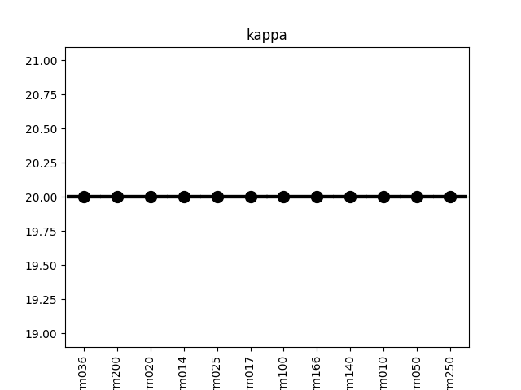
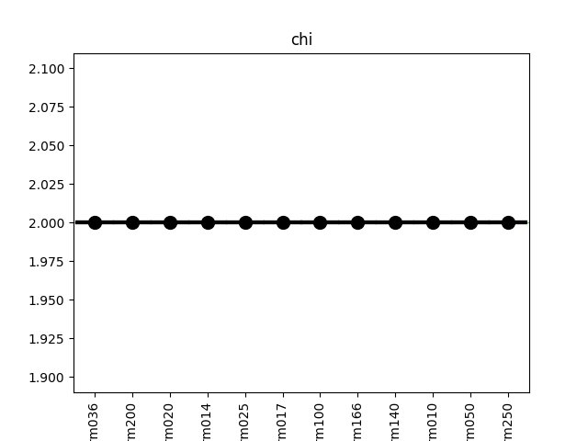
Scan rate parameters for DAP(Project_2)

Slide 31
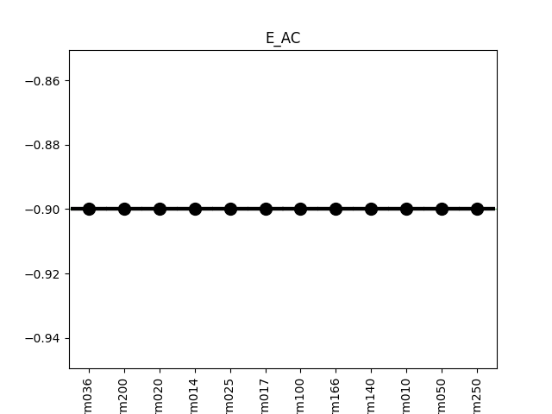
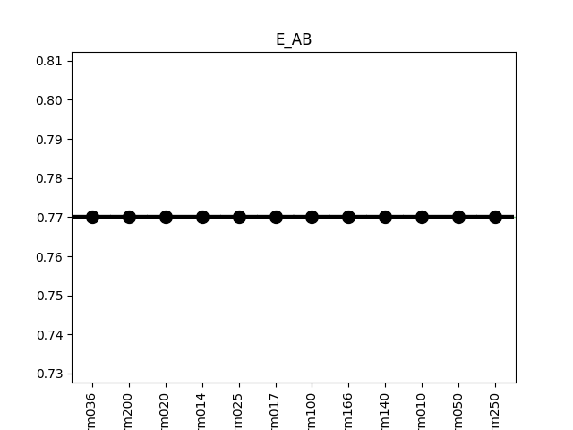

Slide 32



Slide 33



Slide 34
Scan rate parameters for TAP(Project_2)

Slide 35


Slide 36


Slide 37



Slide 38

Energy gap Comparison

Slide 39

Neg-bias fittings for (NO2)4 & (NH2)4(Project_1)
(NO2)4
(NH2)4

Slide 40



(NO2)4 Parameters

Slide 41



Slide 42




Slide 43




Slide 44



(NH2)4 Parameters

Slide 45



Slide 46




Slide 47




Slide 48


Neg-bias fittings for F4 & MeO(Project_1)
F4-HATNA
MeO-HATNA

Slide 49



F4-Parameters

Slide 50



Slide 51




Slide 52




Slide 53



MeO Parameters

Slide 54



Slide 55




Slide 56




Slide 57

Neg-bias fittings for TAP & DAP(Project_2)
TAP
DAP

Slide 58



TAP parameters

Slide 59



Slide 60




Slide 61




Slide 62



DAP Parameters

Slide 63




Slide 64




Slide 65



